Slide 1

Unit 5: Lesson 5:
An email of complaint

Slide 2
Task 1:
Have you ever had to return something
you bought online?
What was the reason of your
dissatisfaction?

Slide 3
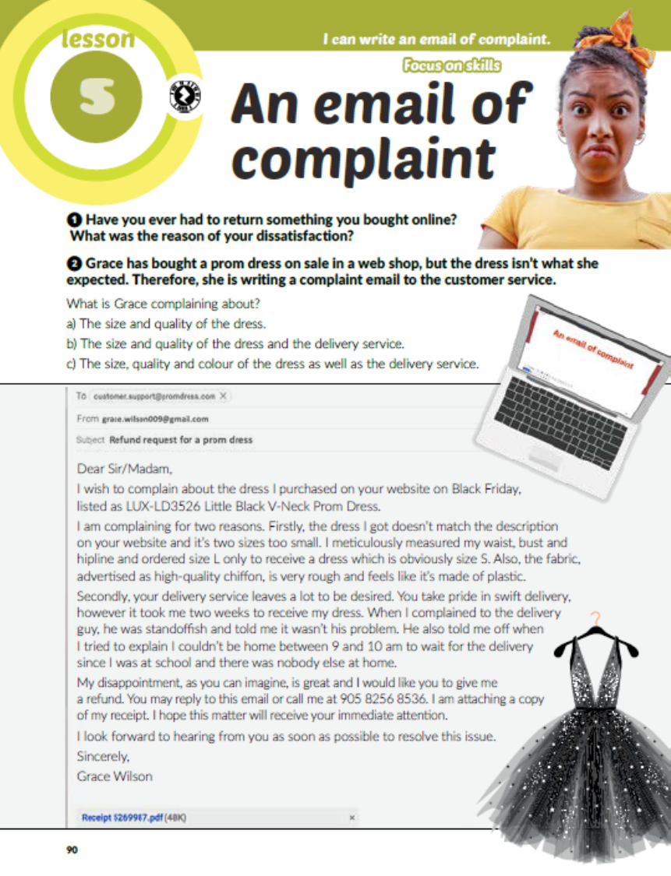
Task 2: What is Grace complaining about in her mail? Read the email and find out.

Slide 4
Task 3: Read Grace’s email again.
Are the sentences true or false?
F
F
T
F
F

Slide 5
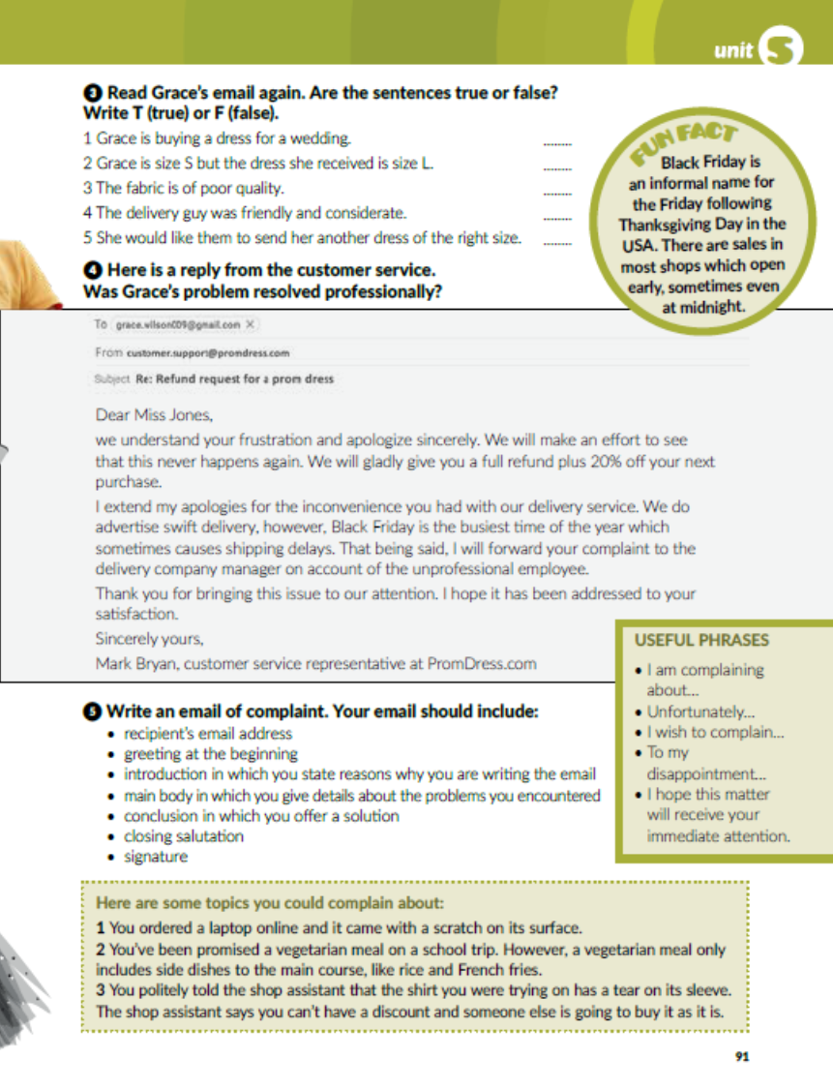
Task 4: Read the reply from the customer service. Was Grace’s problem resolved profesionally?
Yes, it was. They apologized and offered a refund and 20% off her next purchase.

Slide 6

Task 5: Napiši email žalbe. Tvoj email treba sadržavati:
email adresu primatelja
službeni pozdrav na početku
uvod u kojem objašnjavaš razloge svog nezadovoljstva
glavni dio u kojemu navodiš detalje vezane uz nastalu situaciju
zaključak u kojem nudiš rješenje
završni pozdrav
potpis (ime i prezime)
Korisne fraze:
Teme koje možeš iskoristiti u svom emailu.

Slide 7
workbook, page 96
Task 1: Put the parts of Roger’s email of complaint in the correct order.
2
4
6
5
1
7
3

Slide 8
Task 2: Write an appropriate response to Roger’s email as if you were the customer service and offer a compensation for his trouble.

Slide 9

PLAY AND LEARN!
https://www.e-sfera.hr/dodatni-digitalni-sadrzaji/5caf0b52-7eab-4eb0-8ec6-845be186b8b2/

